Slide 1
Instructors Using Coursestorm
lliwcc.coursestorm.com
Updated 1/4/24kc

Slide 2
Instructors = Facilitators in the CourseStorm platform
Curriculum Council will setup all new and existing facilitators into the CourseStorm platform (Beth Johnson)
CC will send Instructors/Facilitators an Invite Email
Instructor accepts and is prompted to setup password
P.S. You will have a password for your instructor staff login, and one for your student login. Your computer usually remembers the last login you used, so you may need to logout as student and login as staff. lliwcc.coursestorm.com

Slide 3
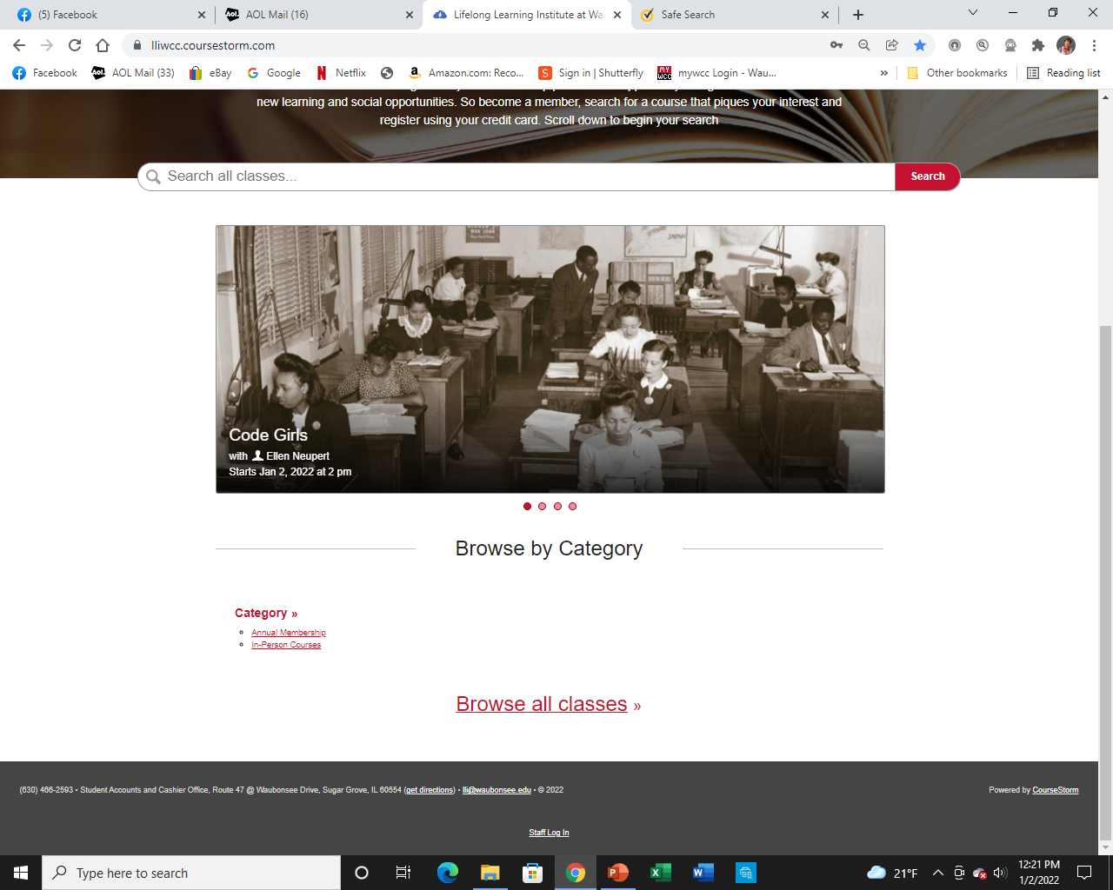
Instructors
Use “Staff
Login” at bottom of Browse page to login for facilitator resources.

Slide 4
LLI instructors will be automatically emailed when:
​A new registration arrives for their class
Someone is added to the waiting list
A student's registration is cancelled
A student is transferred away from their class
A student is transferred to their class
Someone on your staff sends an email to their class roster or waiting list
With these updates, our facilitators will find it easy to stay current on all the classes they teach, automatically!

Slide 5
Using their admin area, instructors can:
See a list of all their classes
View a roster/attendance list for a class
See canceled registrations
View a class waiting list
Download a class roster into Excel
Send an Email to their class roster

Slide 6
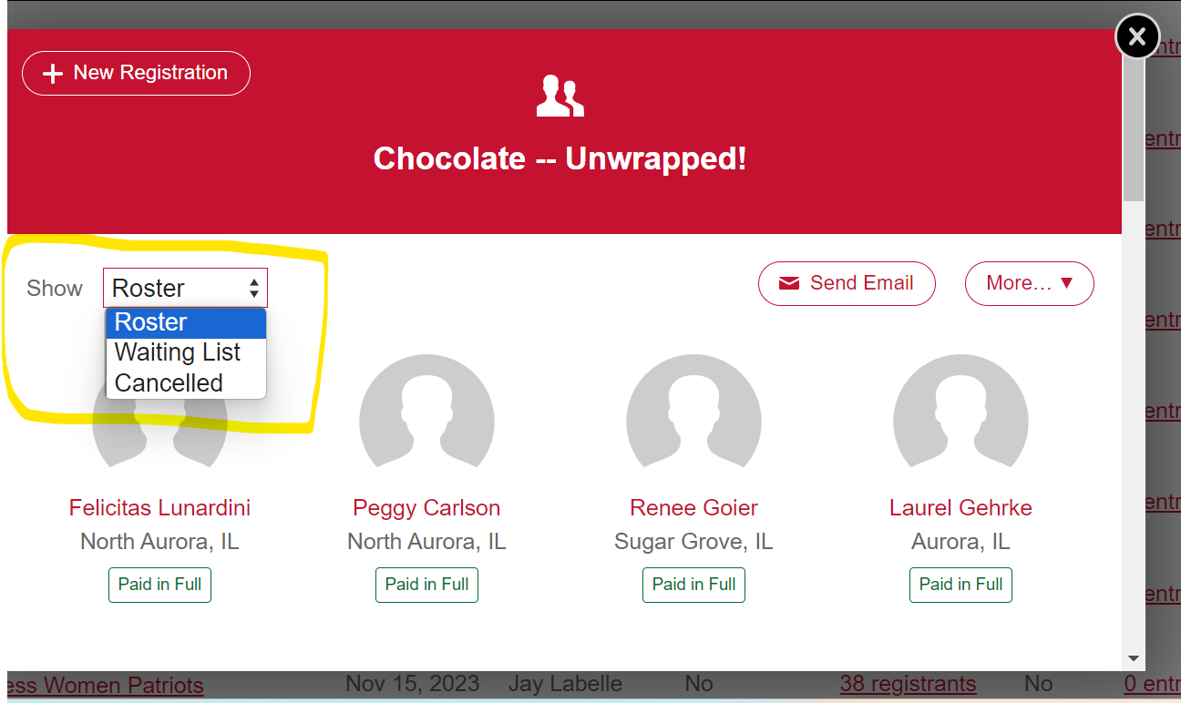
Click on Roster Drop-down box to choose: Roster, Waiting List or Cancelled list.

Slide 7
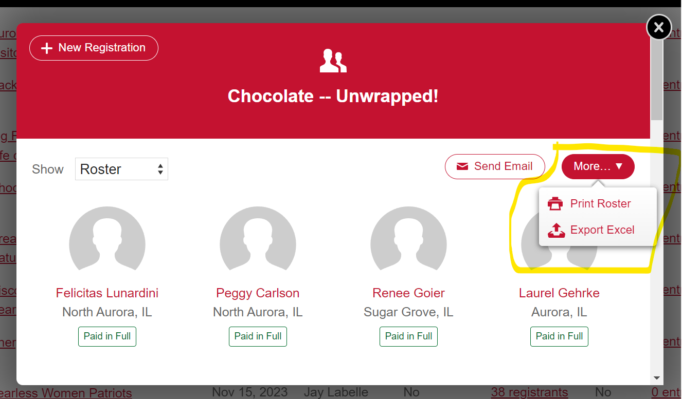
Click on More drop-down box to Print Roster to use for attendance sheet check-in or export file to Excel.

Slide 8
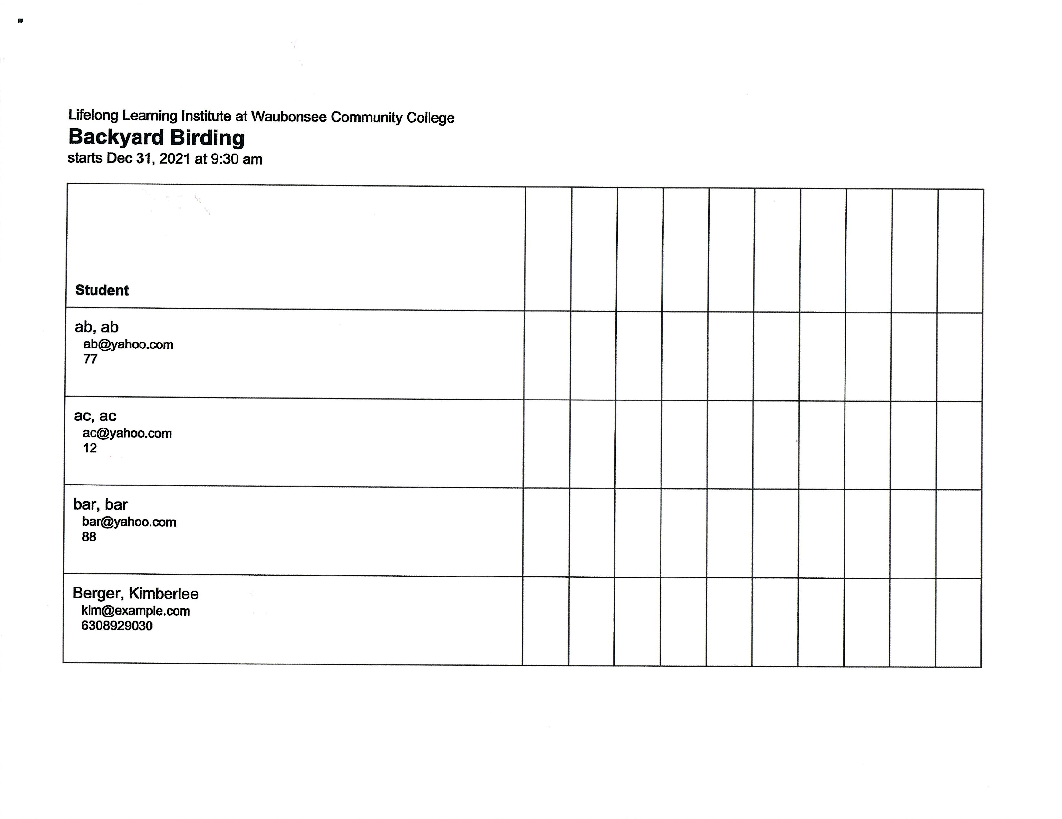
Use this roster as your attendance sheet. Fill in class dates as shown.
2/8 2/15 2/22

Slide 9
Instructors (Facilitators)
Print the roster/attendance sheet, prior to your class (withdrawals and registrations can be made up until the day the class begins) or until the class is full.
(Only one instructor/(facilitator) will be able to have access)

Slide 10
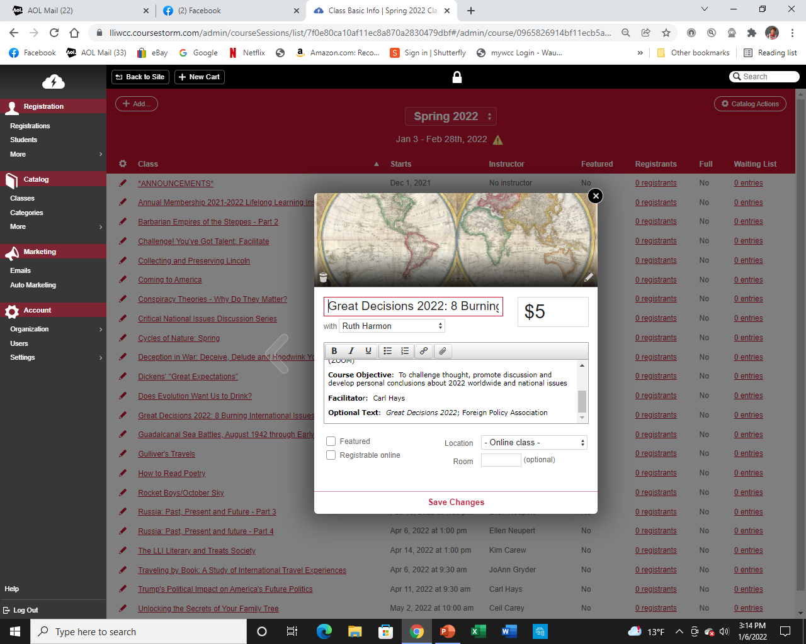

Slide 11
https://coursestorm.atlassian.net/servicedesk/customer/portal/6/article/44 56542?src=-1483981133
Click on above link
Click on Blue link about halfway through CourseStorm screen
Click on White arrow to begin the 2 min. video.

Slide 12
Don’t be afraid to play with the buttons!
You can’t hurt anything.
Benefit: No more emails from Registration telling you to withdraw and add someone to your attendance sheet!

Slide 13
Mail in the completed roster/attendance sheet and evaluations to:
Lifelong Learning Institute at Waubonsee Community College, Rt 47 at Waubonsee Rd, Sugar Grove, IL 60554.
(or give to a Curriculum Council member)

